Slide 1














INTEL PRODUCTS SENTIMENT ANALYSIS FROM ONLINE REVIEWS

Slide 2
Objective: To investigate customer sentiment towards Intel Products using online evaluation.
Solution: Visualize an advanced sentiment analyzer for processing, analyzing, and visualizing sentiment data.
1. Data Collection: Scraped Online Reviews.
2. Preprocessing: Clean and preprocess text data for analysis.
3. Sentiment Analysis: Used NLP techniques to analyze sentiment.
4. Visualization: Provide insightful imagery and suggestion.

Slide 3

Comprehensive Preprocessing:
language identification, translation, and information cleansing .
Clustering:
TF-IDF vectorization and K-Means clustering for pattern recognition.
Features
Offered
Sensitivity Analysis:
Using TextBlob and VADER for more accurate sensitivity scores.
Geoanalysis:
Look at the distribution by country
Exploring Features
Visualization:
Word clouds, perceptual enhancement, and multidimensional representations of emotions
Feature Analysis:
Technical features of emotionally compatible image.

Slide 4
Process Flow
01
02
03
04
05
06
07
Data Collection: Scraped and load amazon reviews of intel core processors.
Data Preprocessing 1.Clean text, expand contractions, and correct spelling.
2. Detect language and translate if necessary.
Sentiment Analysis:
Calculate sentiment scores using TextBlob and VADER.
Feature Extraction:
Identify key product features and their sentiment
scores.
Clustering:
Visualization:
Generate word clouds and sentiment trend plots.
Recommendation:
Based on sentiment analysis and feature performance.
Apply TF-IDF vectorization and K-Means clustering.

Slide 5
Architecture Process:
1.Data Preprocessing:
a. Text cleaning (HTML tags removal, contraction expansion).
b. Tokenization, lemmatization, and stopword removal.
2.Sentiment Analysis:
a.TextBlob for polarity scores.
b.VADER for compound sentiment scores.
3.Clustering:
a.TF-IDF vectorization of cleaned text.
b.K-Means clustering to identify patterns.
4.Visualization:
a.WordCloud for common words.
b.Sentiment trends over time.
c.Feature sentiment mapping.

Slide 6
Technologies Used:
1. Pandas: Data manipulation and analysis.
2. NLTK: Natural Language Processing tasks.
3. TextBlob & VADER: Sentiment analysis tools.
4. BeautifulSoup: HTML and XML parsing.
5. Googletrans: Language detection and translation.
6. SpellChecker: Correcting spelling mistakes.
7. Matplotlib & Seaborn: Data visualization.
8. WordCloud: Word cloud generation.
9. Scikit-Learn: TF-IDF vectorization and K-Means clustering.

Slide 7
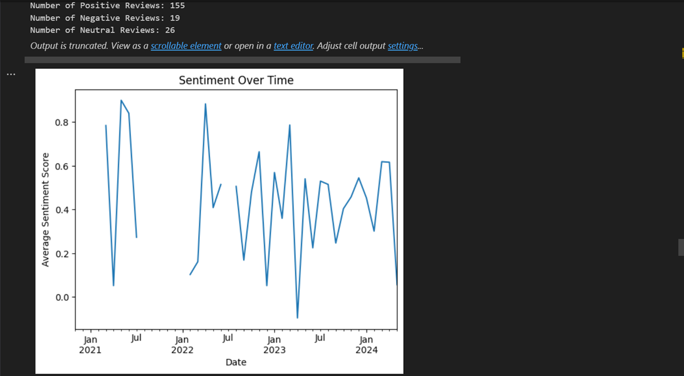
Project Outcomes

Slide 8
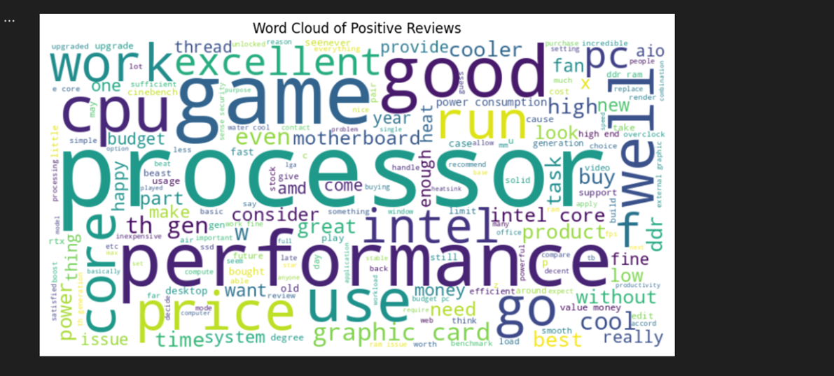

Slide 9
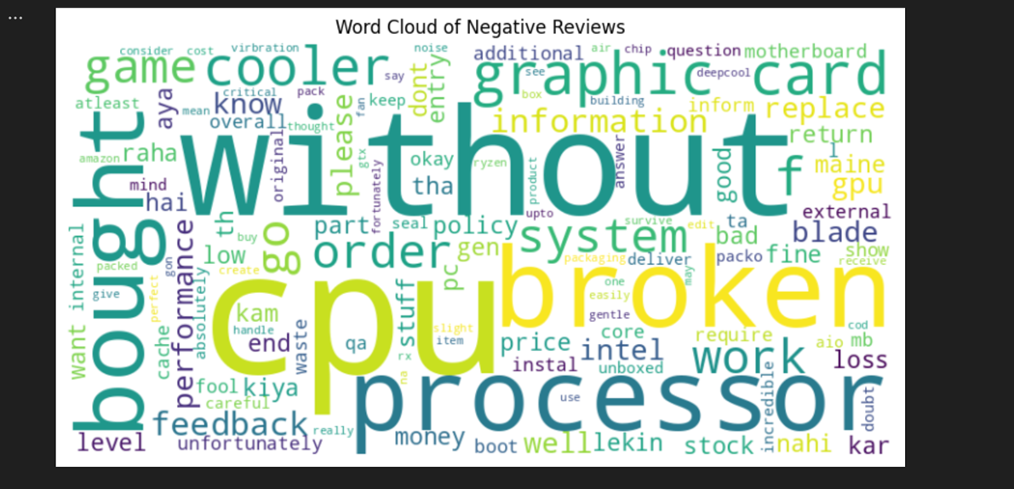

Slide 10
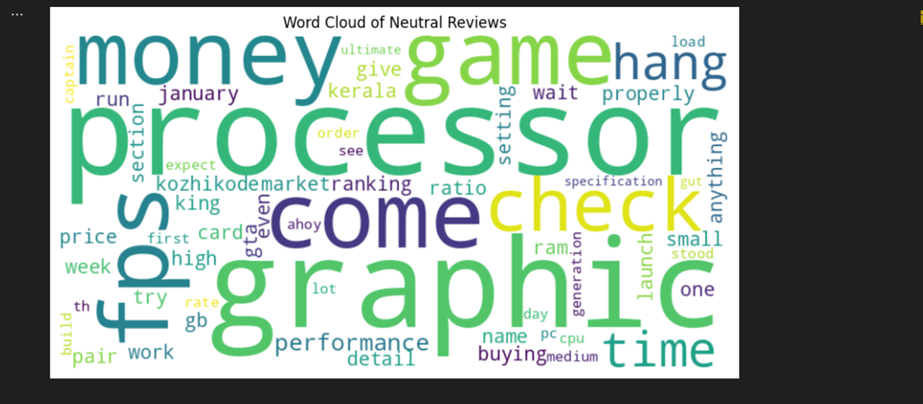

Slide 11
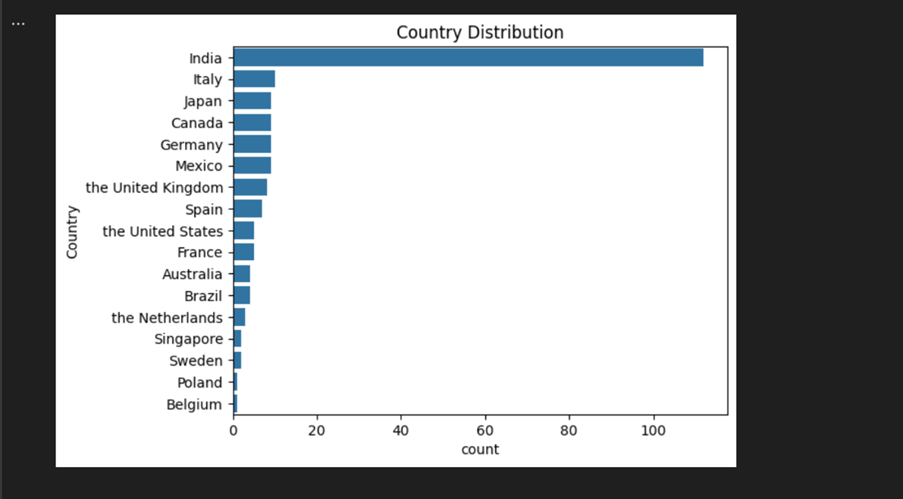
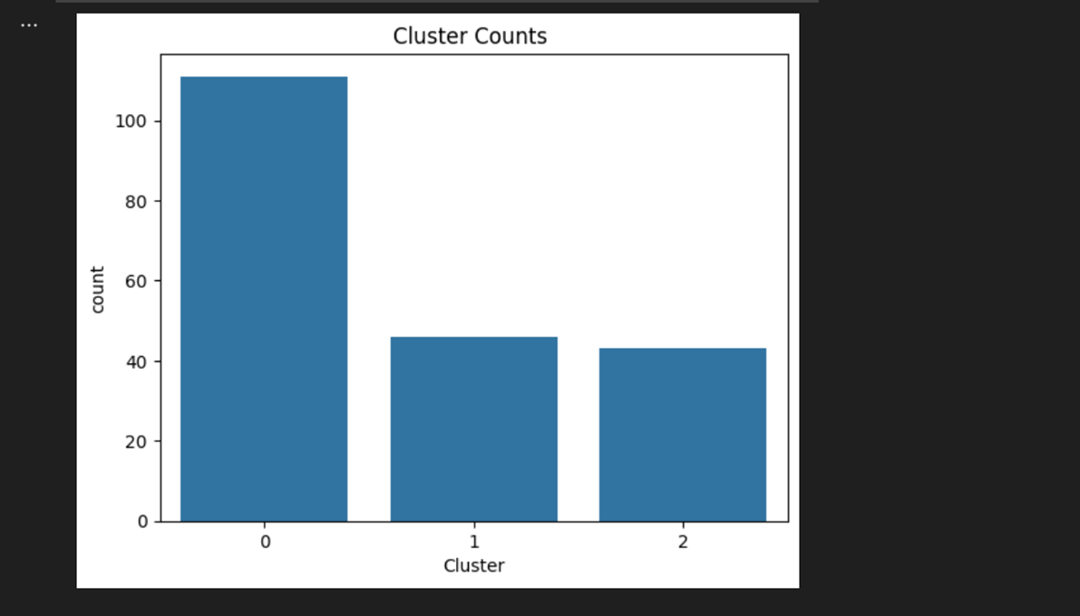

Slide 12
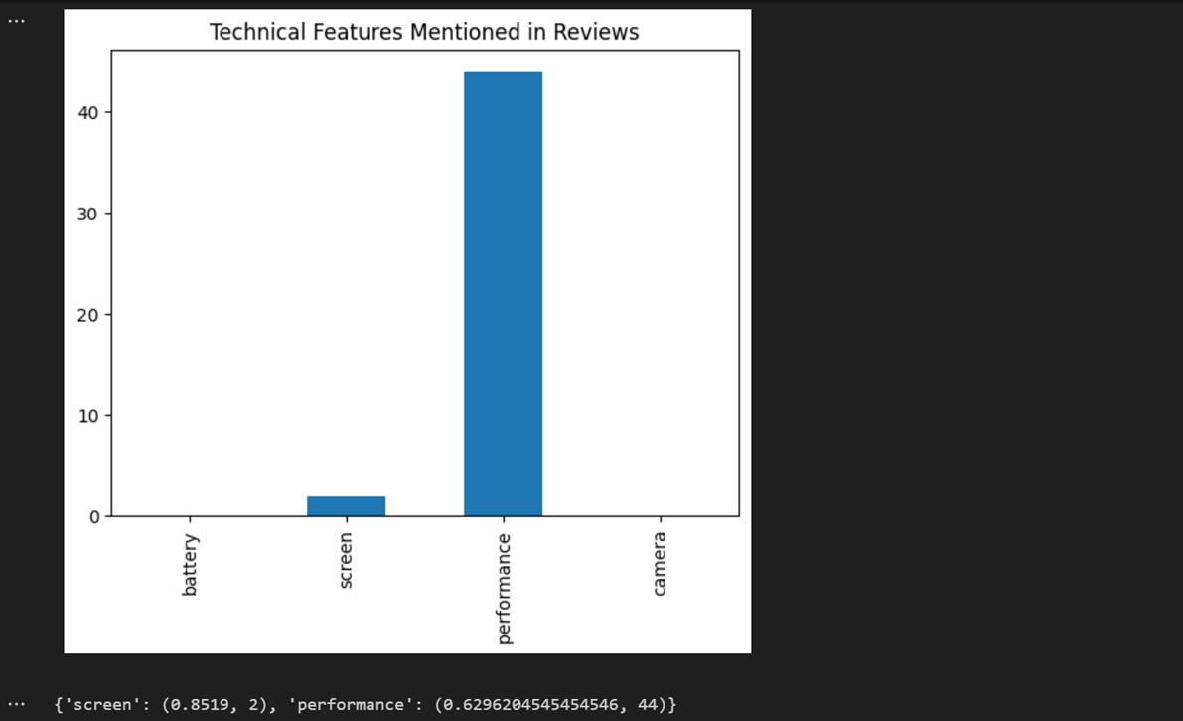

Slide 13
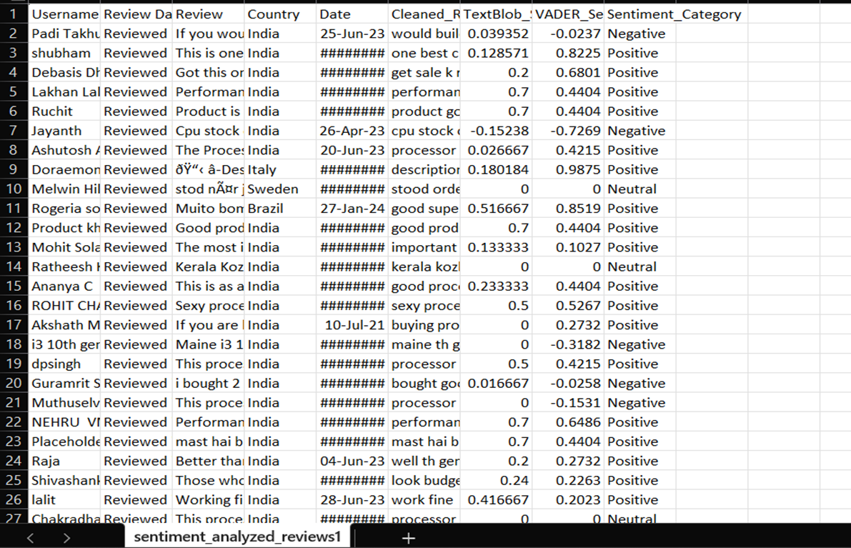
1. Excel files having Sentiment Analysed Data:

Slide 14
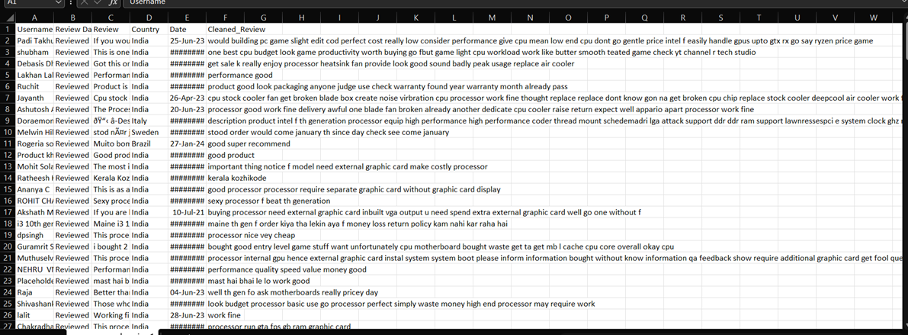
2. Preprocessed excel data:

Slide 15

Conclusion
1.Comprehensive Sentiment Analysis: Provides a detailed understanding of customer sentiment.
2.Actionable Insights: Helps Intel improve products based on customer feedback.
3.Scalable Solution: Can be adapted to other product reviews and industries.
4.Enhanced Customer Experience: By addressing key areas of concern highlighted.

Slide 16
Thank you very much!

